Slide 1


CRYPTO
TRADE QUEST

Slide 2
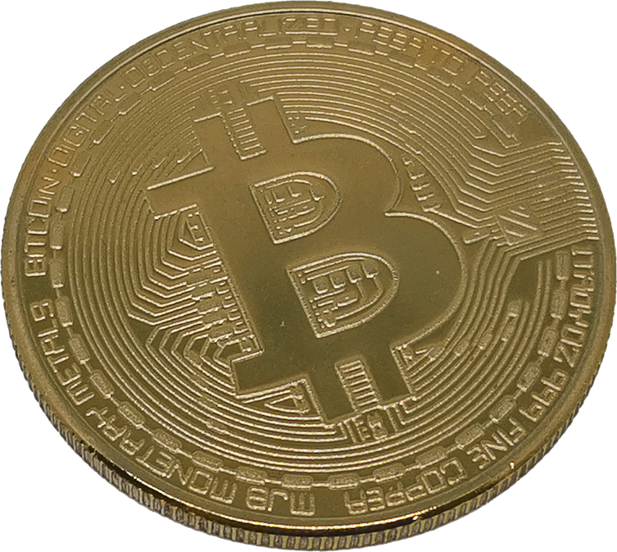



What is
Crypto Trade Quest?
A simplified model of a cryptocurrency exchange, similar to Binance. It is a console based application written in C++ that simulates basic operations of a Cryptocurrency exchange, working on a CSV data file that is approximately 3500 lines. Each line in the CSV file represents a single trade, and its details such as timestamp, product, type of trade and amount.

Slide 3


The Matching
Engine
The matchingEngine() is the core of the project, responsible for matching buy orders (bids) with sell orders (asks) based on the price and quantity of the orders. Here’s how it works:
The function first calls filteringOrderBook() to filter all orders in the order book and store all bid orders in 2 different vectors(BidOrders & AskOrders) with respect to time.
Then it calls SortingOrders() to sort these 2 vectors. Bid orders are sorted in descending order of price while ask orders are sorted in ascending order.
Then it matches orders by going through each bid order and each ask order. If the bid price is higher than or equal to ask price, products are the same, and bid amount is less than or equal to ask amount, a trade can occur.
When a match is found, trade is executed and quantities of the matched bid and ask are reduced accordingly. If bid amount is equal to ask, both are set to zero. If bid amount is less than ask, ask amount is reduced by bid amount, and the bid amount is set to zero. If bid amount is greater than ask amount, bid amount is reduced by ask amount, and the ask amount is set to zero.
The Wallet is updated using the Assets.UpdateWallet(i) function.
Details of the trade are recorded in the Sales vector.
Lastly, the function calls TotalSales(Sales) to count the number of sales for each product and returns this data as a map where keys are product names and values are number of sales.

Slide 4

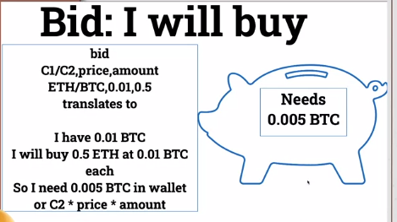
What is a BID?

Slide 5

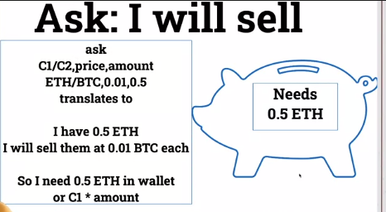
What is an ASK?

Slide 6
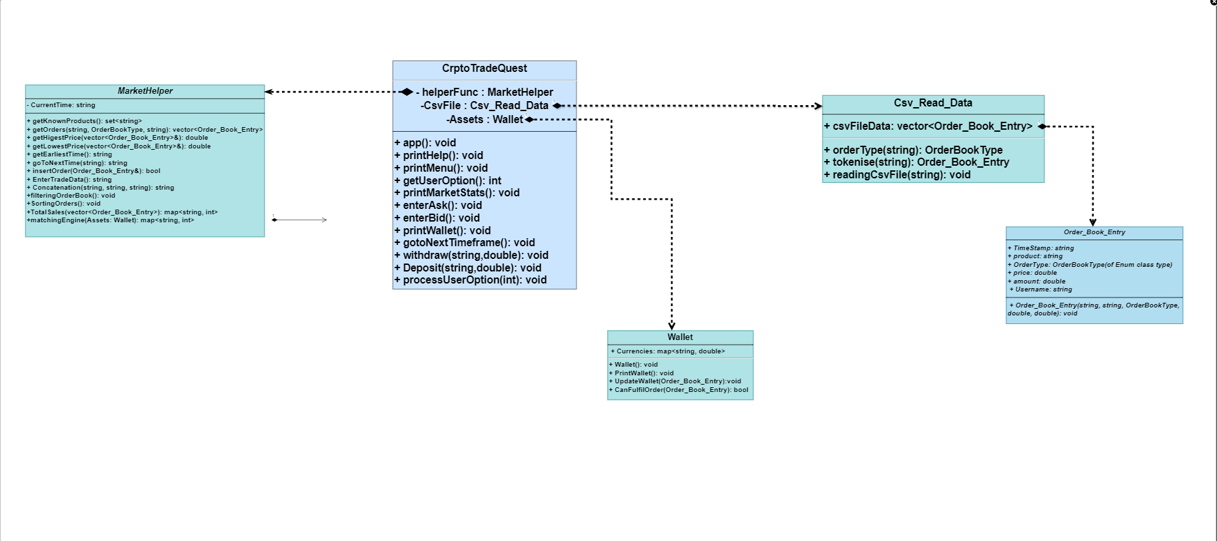
UML DIAGRAM

Slide 7
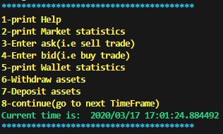
PROJECT MENU
This is the basic menu for the project.
Print Help for any queries.
Prints market statistics about bids or asks (choice dependent)
Enter the product, price and amount for an ask i.e. sell
Enter the product, price and amount for a bid i.e. buy
Prints the current contents of your wallets (Product and Amount)
Withdraw resources from your wallet
Deposit resources to your wallet
Go to the next timeframe

Slide 8

PROJECT COMPONENTS
CSV file
Crypto_Trade_Quest
CSV_Data_Read
Market_Helper
Order_Book_Entry
Wallet

Slide 9
What problem
are we trying to solve?
The goal is to allow a user to interact with a simulated cryptocurrency market, placing buy and sell orders, viewing market statistics, and managing their wallet.

Slide 10


The main loop of the program is in the app() function. It continuously prints a menu of options for the user, gets their choice, and processes it. The options include printing help, printing market statistics, entering a sell or buy trade, printing wallet statistics, withdrawing assets, depositing assets, and moving to the next timeframe.
The printMenu() function displays the options to the user. The getUserOption() function gets the user's choice. The processUserOption(int input) function processes the user's choice and calls the appropriate function based on the user's input.
The printMarketStats() function prints statistics about the current state of the market. The enterAsk() and enterBid() functions allow the user to enter a sell or buy trade respectively. The printWallet() function prints the contents of the user's wallet. The withdraw(string product, double amount) and Deposit(string product, double amount) functions allow the user to withdraw or deposit assets. The gotoNextTimeframe() function moves the market to the next timeframe and matches any outstanding orders.
How does the
Code work?

Slide 11
Expectations
about the output
The output of the program should be interactive, providing the user with information about the state of the market, their wallet, and the results of their trades. It should also handle invalid inputs gracefully, providing helpful error messages.

Slide 12


Future
Goals
To make this app more efficient and able to handle larger data samples with the help of advance data structures. Implement a GUI application for better visual representation of the data.

